Slide 1
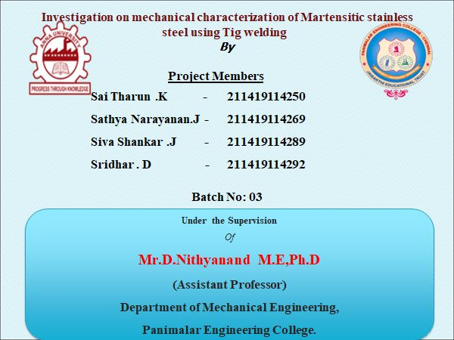

Slide 2
ABSTRACT:
Cold Metal Transfer (CMT) is a modified metal inert gas welding process based on short – circuiting the transfer process, characterised by low heat input and no-spatter welding. The mechanical characterisation have been studied by the tensile test using Universal Testing Machine (UTM). The process was used to join SS430 material in the form of Lap Joint. The results shows that no – spatter welding and low heat input during the welding process can be realized by Cold Metal Transfer, and a similar metal joint with good performance can be obtained by CMT process. In this proposed work we have fabricated the tensile test fixture for lap joint, which that the sample is coaxial in nature and the same is welded and bisected using wirecut edm and the tested using the above mentioned fixture and the results are observed and tabulated.

Slide 3
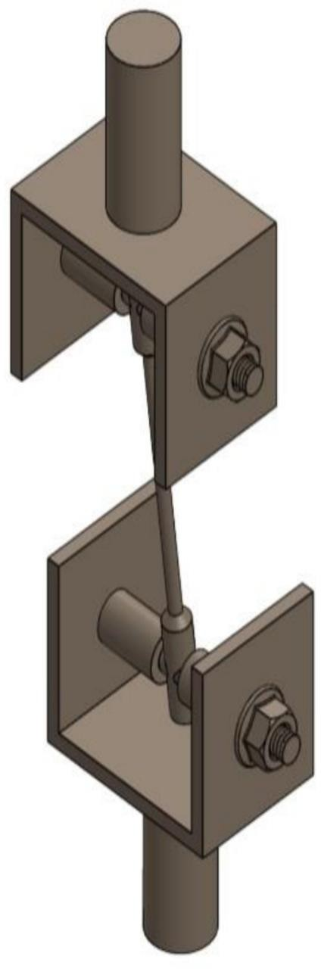

Slide 4
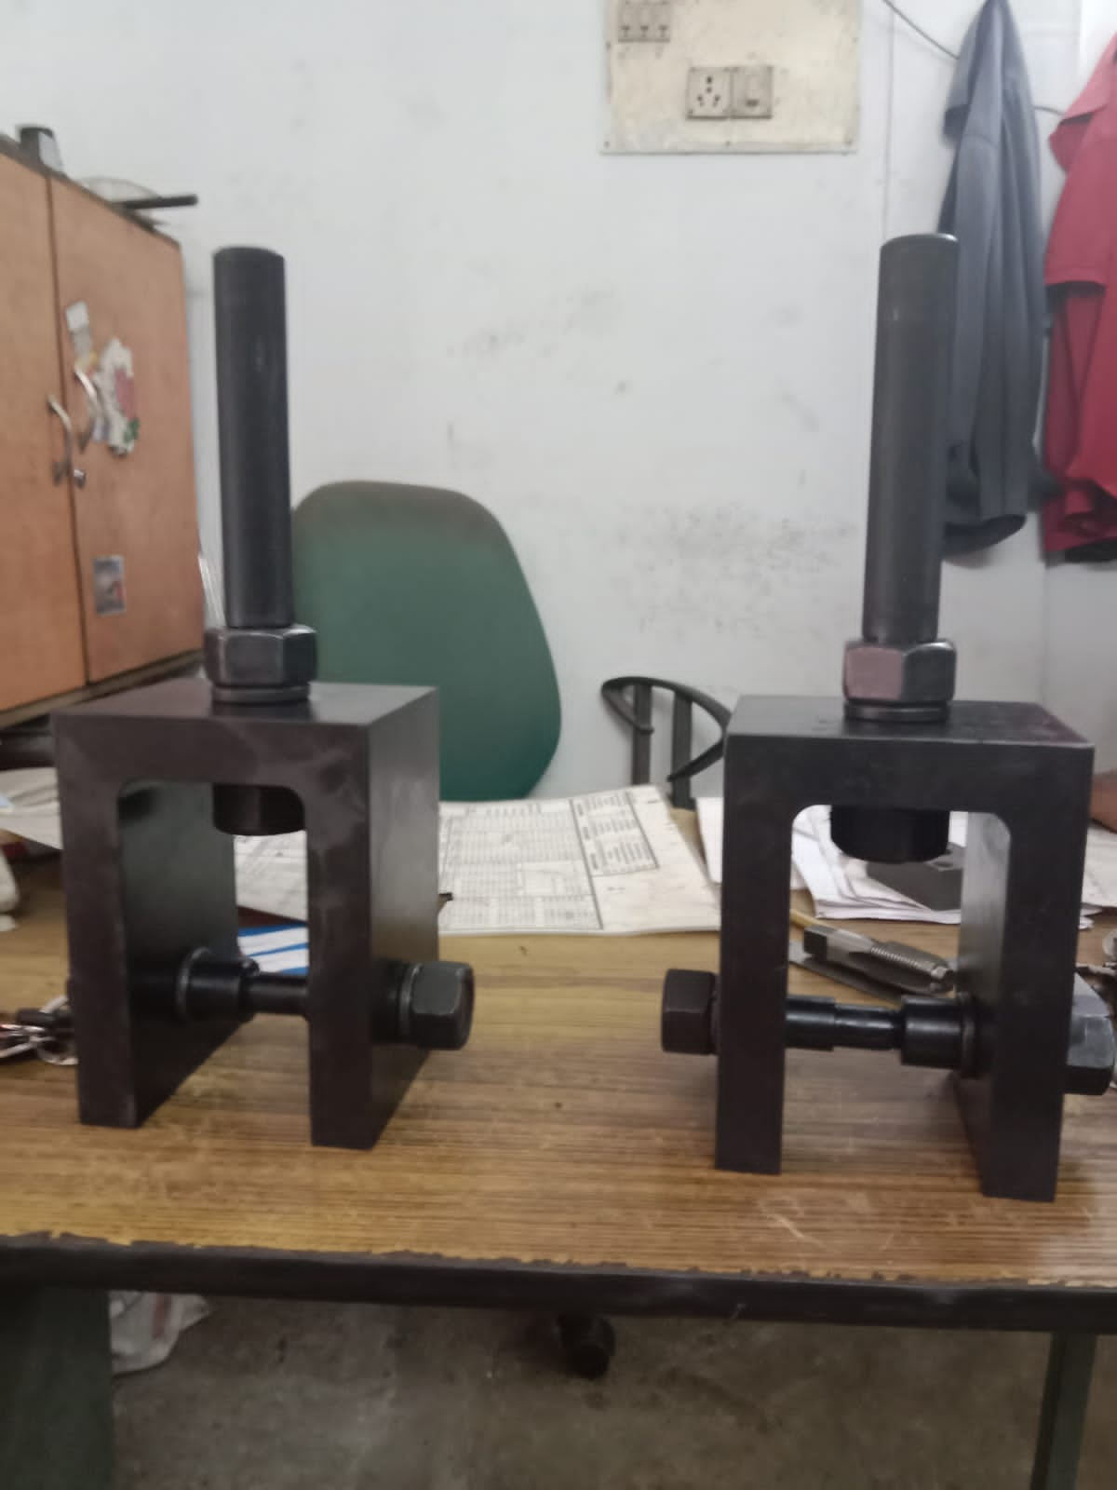
FIXTURE

Slide 5
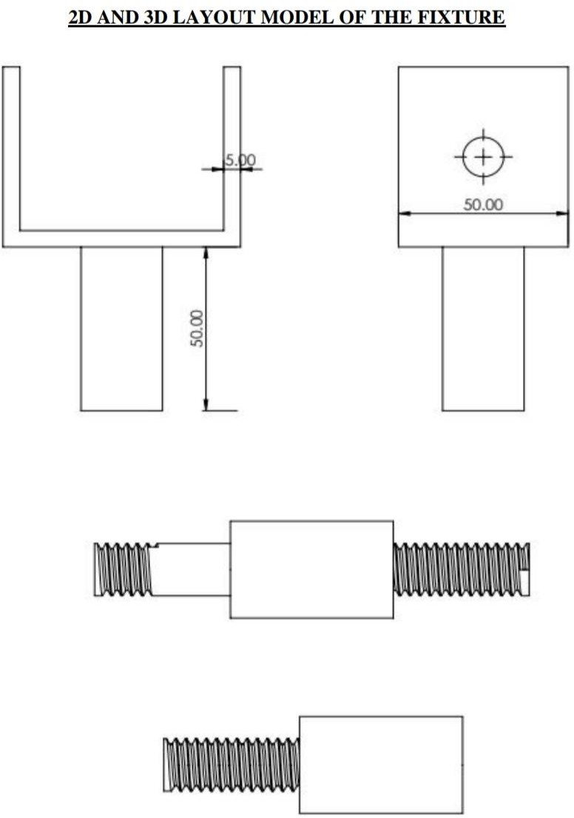

Slide 6
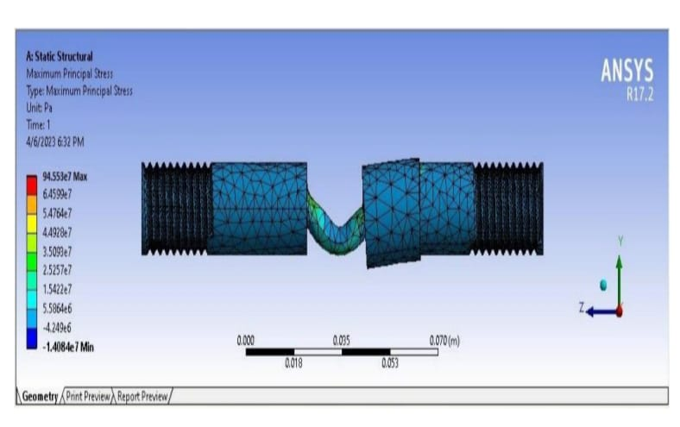
STRESS ANALYSIS ON PIN

Slide 7
MATERIAL USED:
D2 steel is used in the fixture which is an air hardening, high-carbon, high-chromium tool steel. It has high wear and abrasion resistant properties. It is heat treatable and will offer a hardness in the range 55-62 HRC, and is machinable in the annealed condition. D2 steel shows little distortion on correct hardening. D2 steel’s high chromium content gives it mild corrosion resisting properties in the hardened condition.
If you need better machinability then consider A2 Tool Steel which has a chromium content of 5% and is more readily machinable.

Slide 8
MATERIAL PROPERTIES OF SS430 :
As ferritic steels go, 430 stainless steel is the most common. It is used in a variety of applications, mostly indoors. Its high chromium content offers great corrosion resistance, especially under normal atmospheric conditions. It is able to form passivated chromium oxide barriers, which are both tough and durable. And it’s high chromium content allows the 430 grade to self-renew this thin protective layer particularly fast. 430 stainless steel resists chloride-induced stress corrosion cracking better than many ferritic steels. It also holds up well against corrosion in the presence of dilute organic acids and many alkalis. This makes stainless steel 430 ideal for use in kitchen applications, such as utensils and working areas. It has also been shown to resist nitric acid well, making it suitable for certain chemical applications.

Slide 9
CHEMICAL COMPOSITION OF SS430 :
ELEMENTS | CONTENT(%)
CHROMIUM | 16%-18%
NICKLE | 0.5%
MANGANESE | 1%
SILICON | 1%
CARBON | 0.12%
SULPHUR | 0.03%
PHOSPHOROUS | 0.04%
IRON | 80%

Slide 10
TIG WELDING:
Tungsten Inert Gas (TIG) welding, also known as Gas Tungsten Arc Welding (GTAW) is an arc welding process that produces the weld with a non-consumable tungsten electrode. Tungsten inert gas (TIG) welding became an overnight success in the 1940s for joining magnesium and aluminium. Using an inert gas shield instead of a slag to protect the weldpool, the process was a highly attractive replacement for gas and manual metal arc welding. TIG has played a major role in the acceptance of aluminium for high quality welding and structural applications.

Slide 11
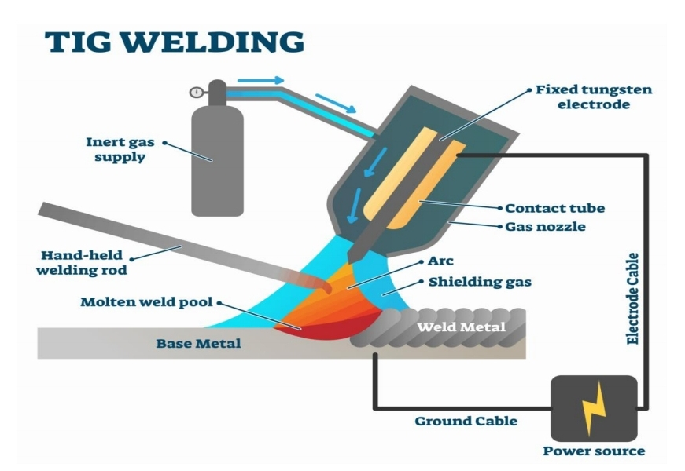

Slide 12
WELDING MACHINE SPECIFICATIONS :
PRODUCTS TYPE | TIG 250
Model | RT 25
Input Voltage (V) | AC 415 + 15%
Rated Input | 0.9 / 13.0
Power (KVA) | 9.5
No- load voltage | 70
Output current range | 10-250
Rated output voltage (V) | 30
Duty cycle | 60
No load loss (W) | 40
Efficiency | 85

Slide 13
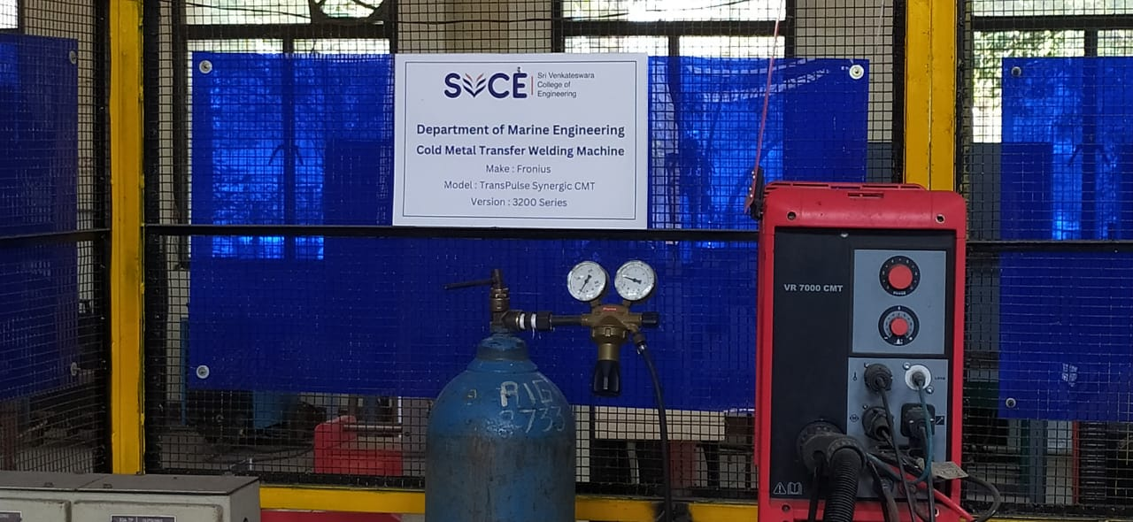
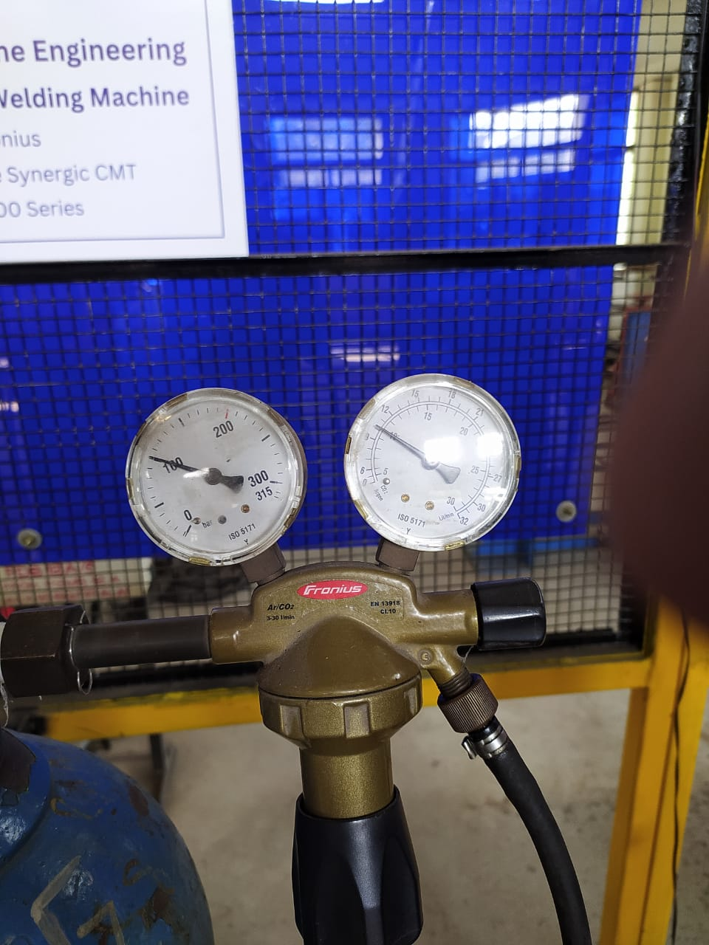
ARGON GAS
PRESSURE GAUGE

Slide 14
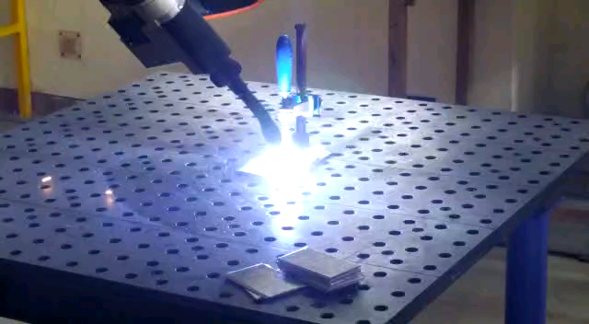
WELDING PROCESS

Slide 15
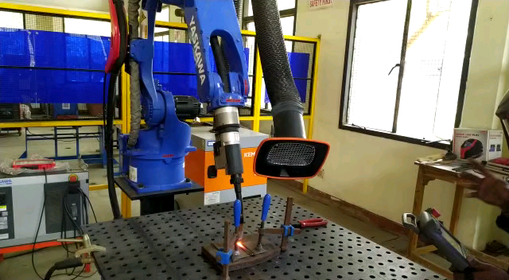

Slide 16
TENSILE TESTING :
As mentioned earlier the tensile test is used to provide information that will be used in design calculations or to demonstrate that a material complies with the requirements of the appropriate specification – it may therefore be either a quantitative or a qualitative test. the test is made by gripping the ends of a suitably prepared standardized test piece in a tensile test machine and then applying a continually increasing uniaxial load until such time as failure occurs. Test pieces are standardized in order that results are reproducible and comparable as shown.

Slide 17
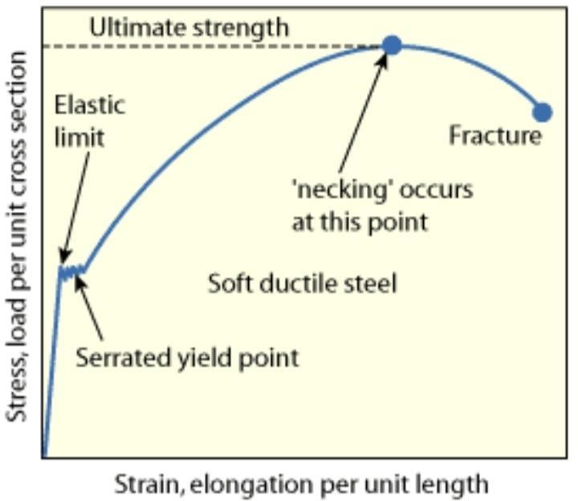

Slide 18
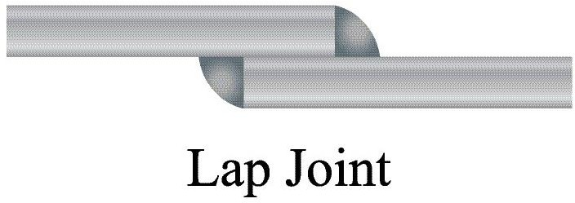
The image of the Lap joint’s test piece is given as follow,
The Fixture we had fabricated is used to determine the tensile strength of the model of
the above lap joint’s test piece by using Universal Testing Machine (UTM).

Slide 19
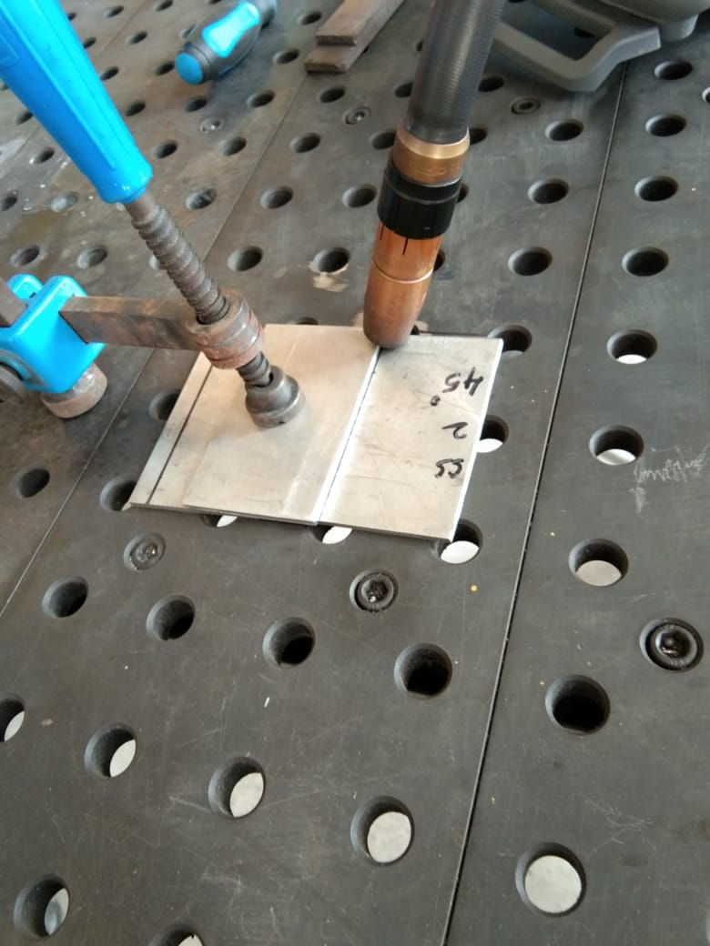
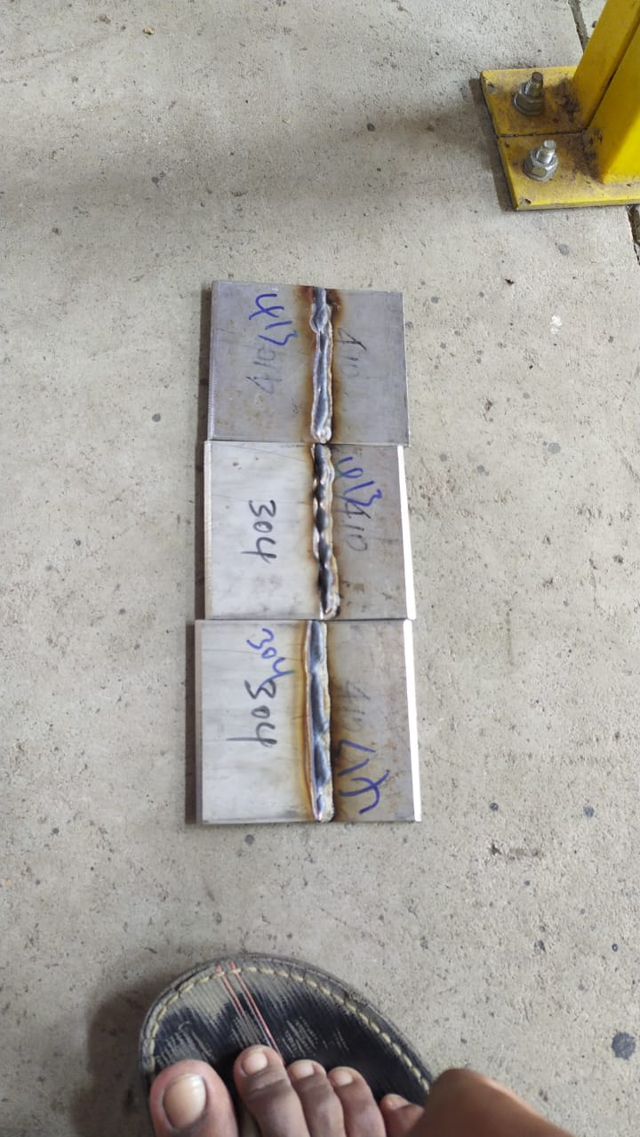
LAP JOINT
Before
After

Slide 20
WIRE CUT ELECTRICAL DISCHARGE MACHINE :
Wire electrical discharge machining (EDM) is a process of metal machining in which a tool discharges thousands of sparks to a metal workpiece. A non-conventional process, though hardly a new one, wire EDM works on parts resistant to conventional machining processes, but only if these parts are electrically conductive; usually, they are non-ferrous, and include steel, titanium, superalloys, brass, and many other metals. Instead of cutting the material, EDM melts or vaporizes it, producing comparatively small chips and providing a very accurate cut line. Industry-wide acceptance has led to a wide variety of EDM applications, as it is highly versatile, can cut hard metals, and utilizes a relatively compact amount of workspace.

Slide 21
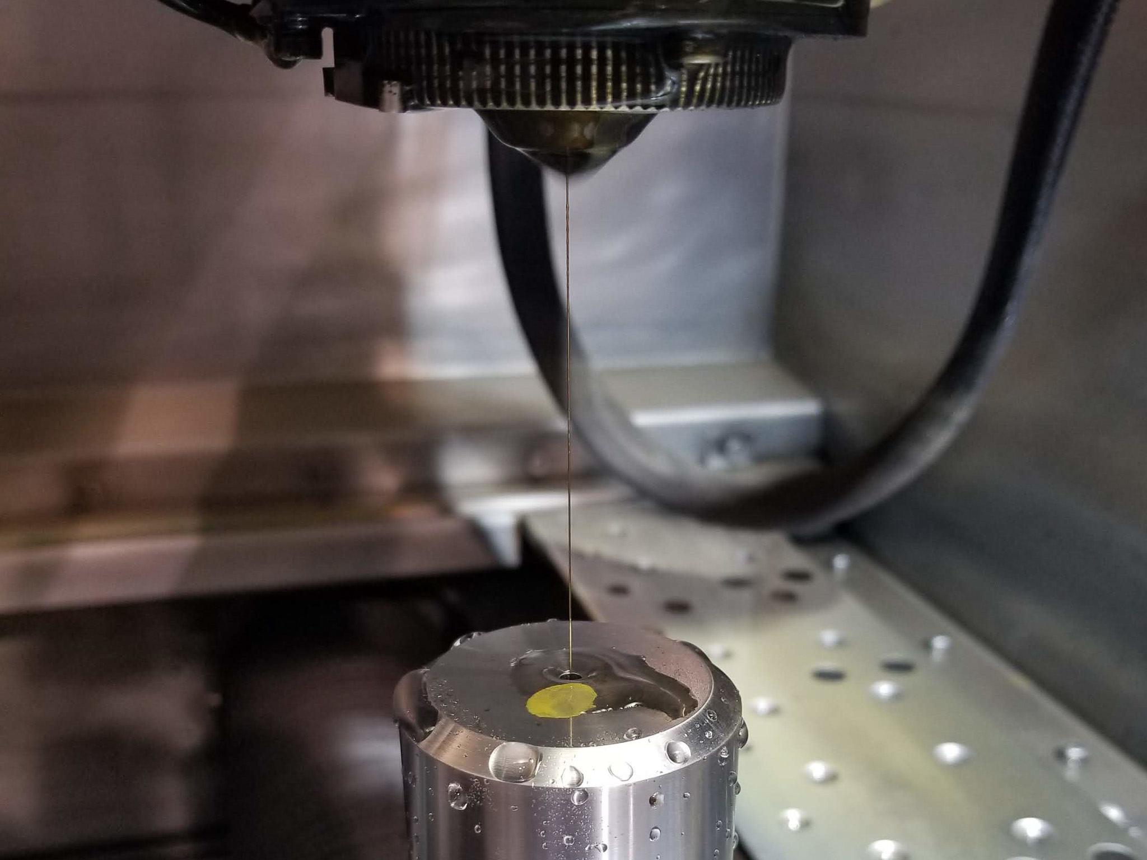
EDM MACHINE :

Slide 22
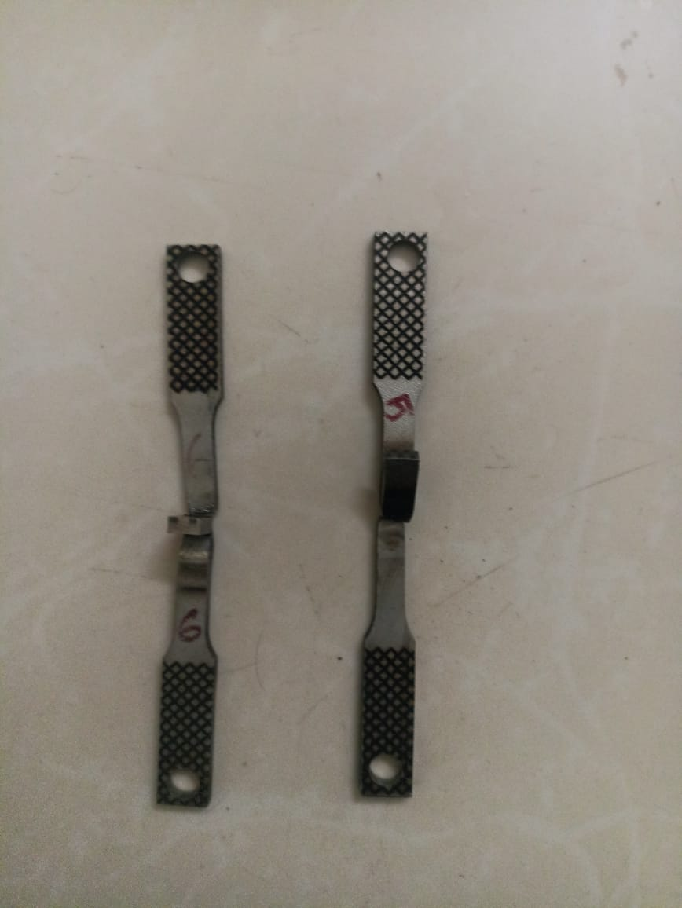
TEST SPECIMEN :

Slide 23
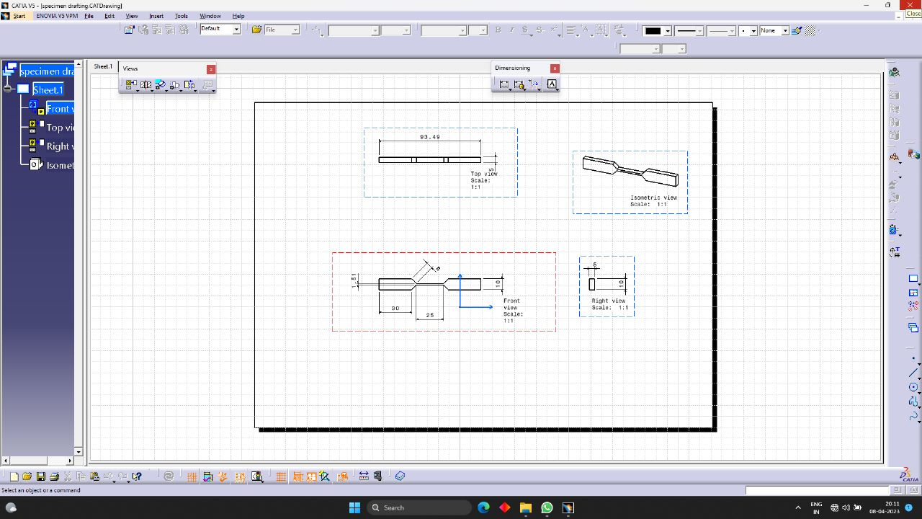
LAYOUT OF TEST SPECIMEN :

Slide 24
UNIVERSAL TESTING MACHINE (UTM) :
A universal testing machine, often known as a UTM machine, is a kind of testing machine that applies a tensile, compressive, and transverse load on a sample in order to determine the mechanical characteristics of that material. A universal testing machine can perform a variety of tests by only requiring the user to change the grips and fasteners that are attached to it. Metals, concrete, rubber, and textiles are some of the materials that may be tested using this machine.

Slide 25
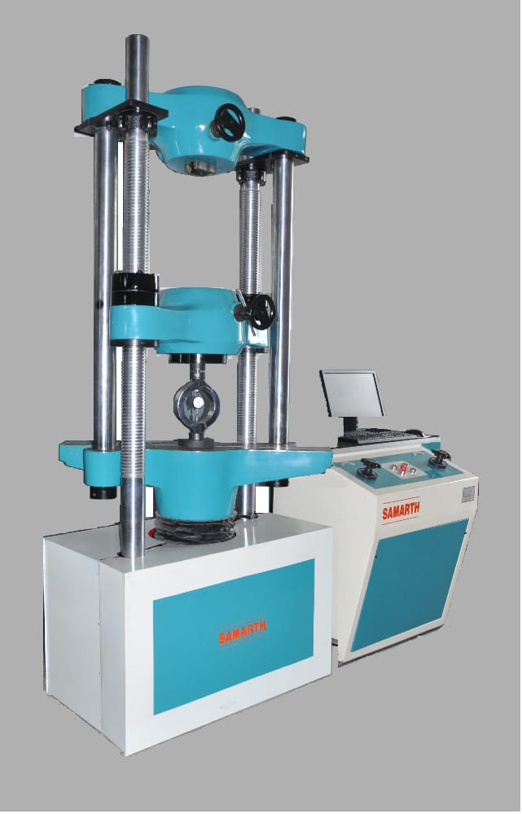
Universal Testing Machine (UTM)

Slide 26
RESULT :
NO OF TEST TRIALS | 1 | 2
AMPS | 150 | 170
VOLTS | 18 | 22
GAS PRESSURE | 4 | 5
TENSILE LOAD (KN) | 18.21 | 17.58
TENSILE STRENGTH (N/mm2) | 505.22 | 615.73

